Slide 1

A PRESENTATION ON
CAR RENTAL
SYSTEM
Prepared by: Subash Gurung, Rikita Gharti, Namrata Bastola, R.A.Mon Tiwari

Slide 2
Fleet-Ease, the ultimate solution for car rental management
Fleet-Ease combines efficiency and convenience, ensuring reliable operations
Utilizing performance optimization strategies for seamless operation, Fleet-Ease ensures a smooth and efficient rental process
INTRODUCTION​

Slide 3
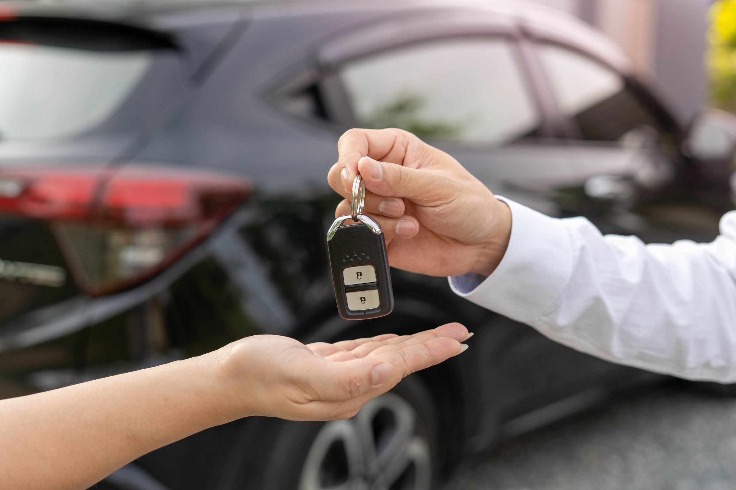
PROBLEMS
Inefficient Manual Processes​
Economic Efficiency​
Poor Customer Experience
Complex Interface
Limited Accessibility

Slide 4
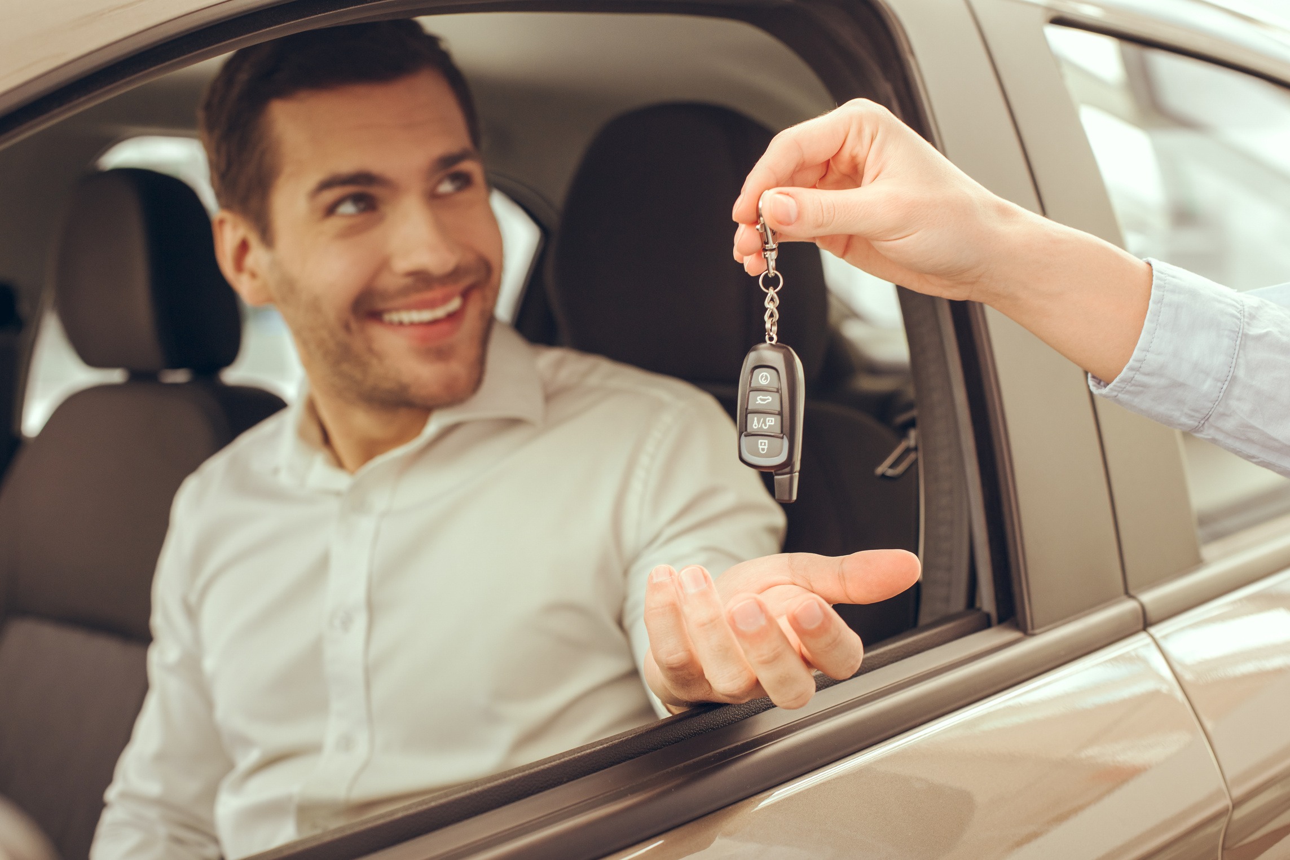
OBJECTIVES
Easiness in Rental Processes​
Enhanced User Experience​
Real-time Availability Updates​
Secure Data Management​
Cost Efficiency

Slide 5
Our Requirements
Functional Requirements
User Registration and Authentication
User Management with User Types
Car Inventory Management
Rental Management
Non- Functional Requirements
Performance
Reliability
Security

Slide 6
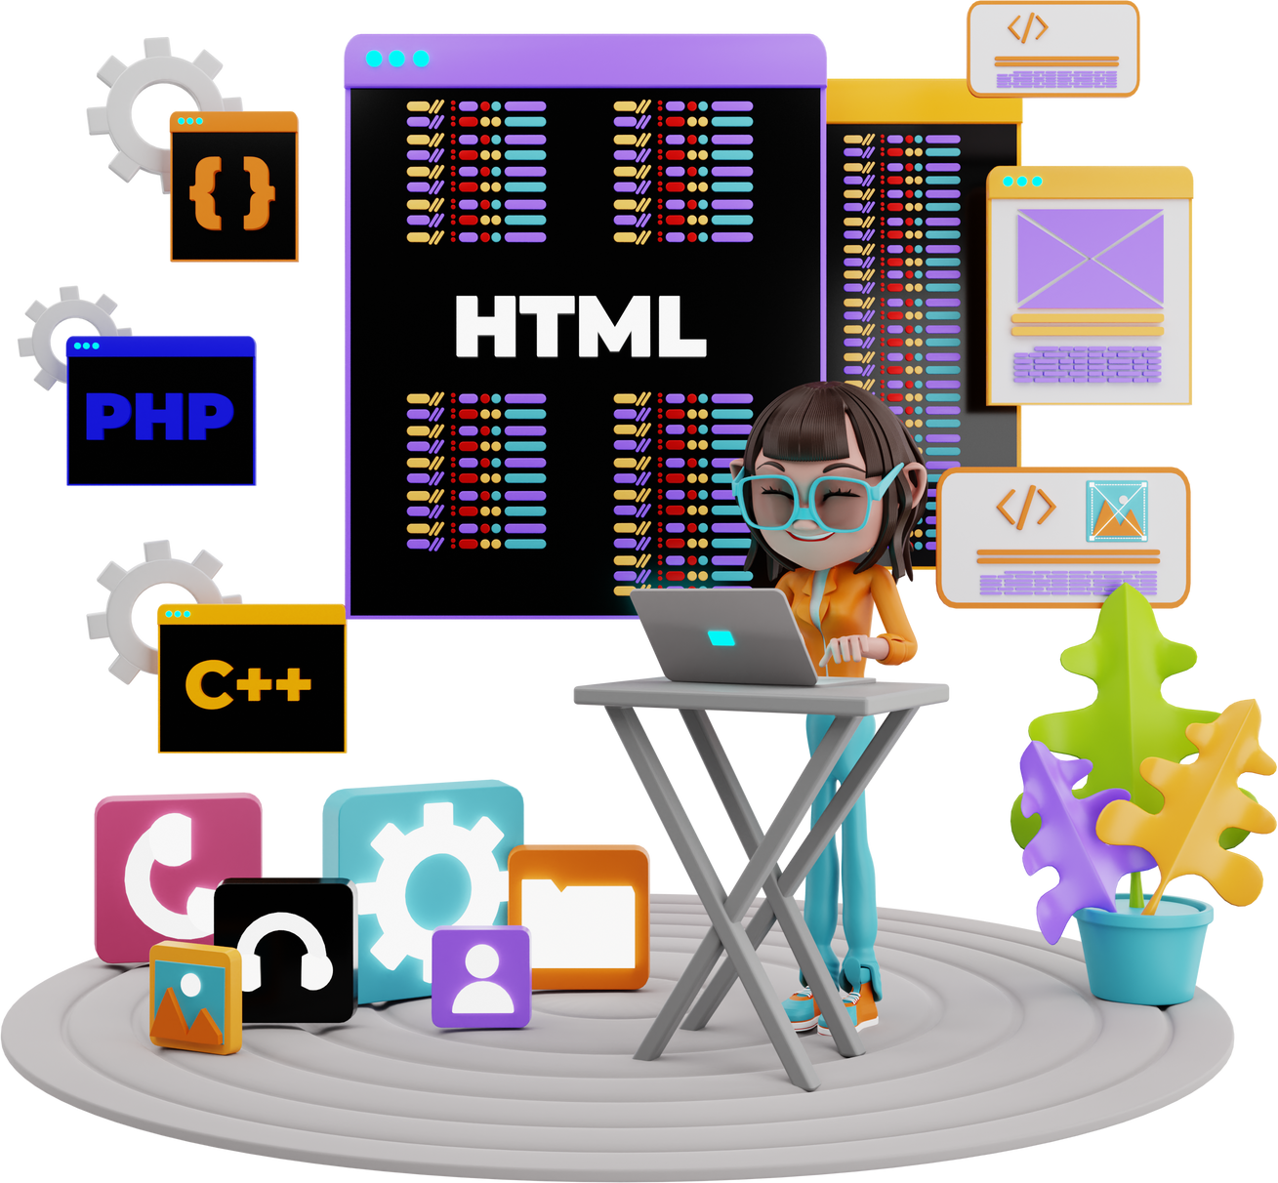
DEVELOPMENT
MS POWERPOINT:
For Presentation slides
ADOBE PHOTOSHOP:
For graphical logos
DISCORD:
For meetings
DRAW.IO:
For Diagrams
MS WORD:
For Gantt Chart
VISUAL STUDIO 2022:
For coding
For DATABASE
MSQL:

Slide 7
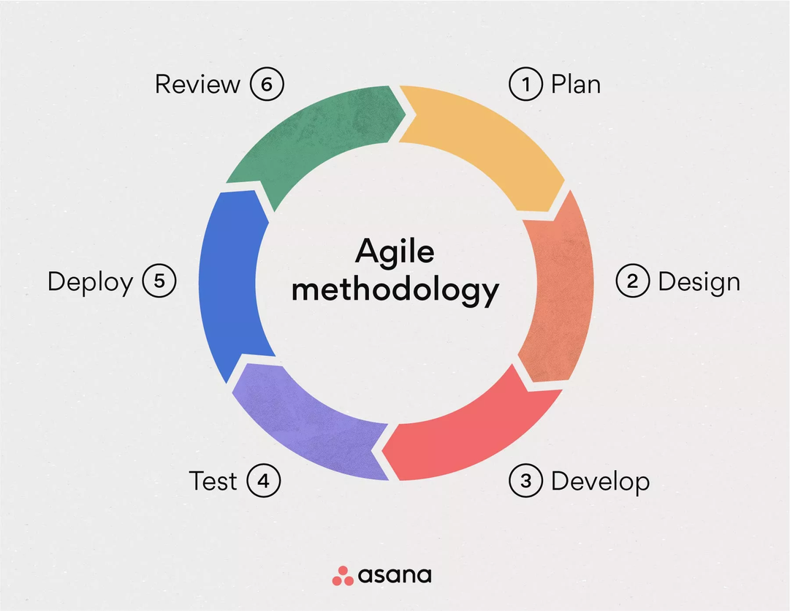
METHODOLOGY
Agile methodologies emphasize iterative development, collaboration, and flexibility in response to changing requirements.
Allows for frequent feedback loops, early delivery of working software, and close collaboration between the coder and documentation team.

Slide 8
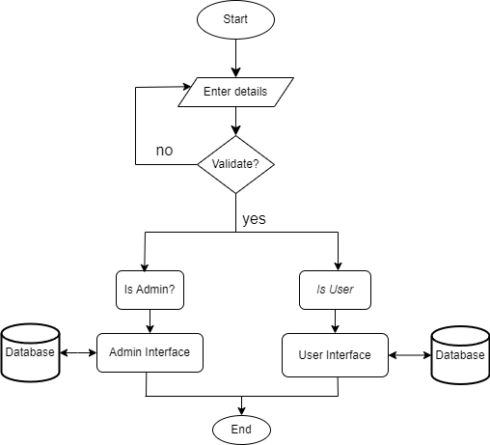
FLOWCHART I:

Slide 9
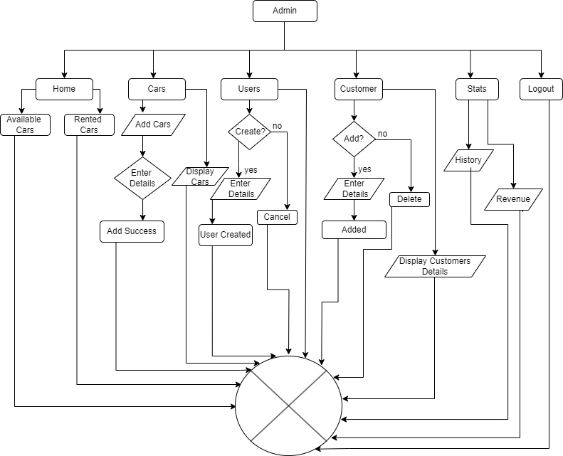
FLOWCHART II:

Slide 10
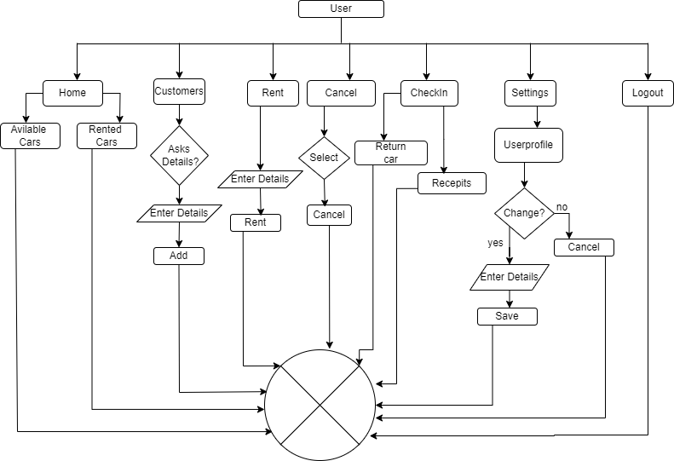
FLOWCHART III:

Slide 11
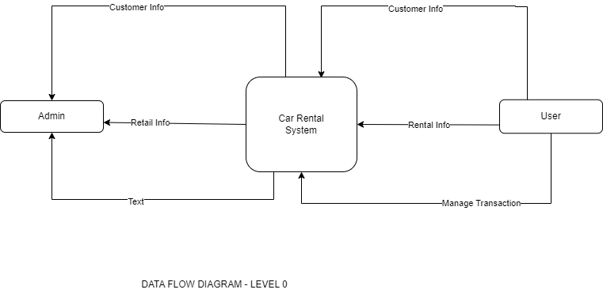
DFD 0:

Slide 12
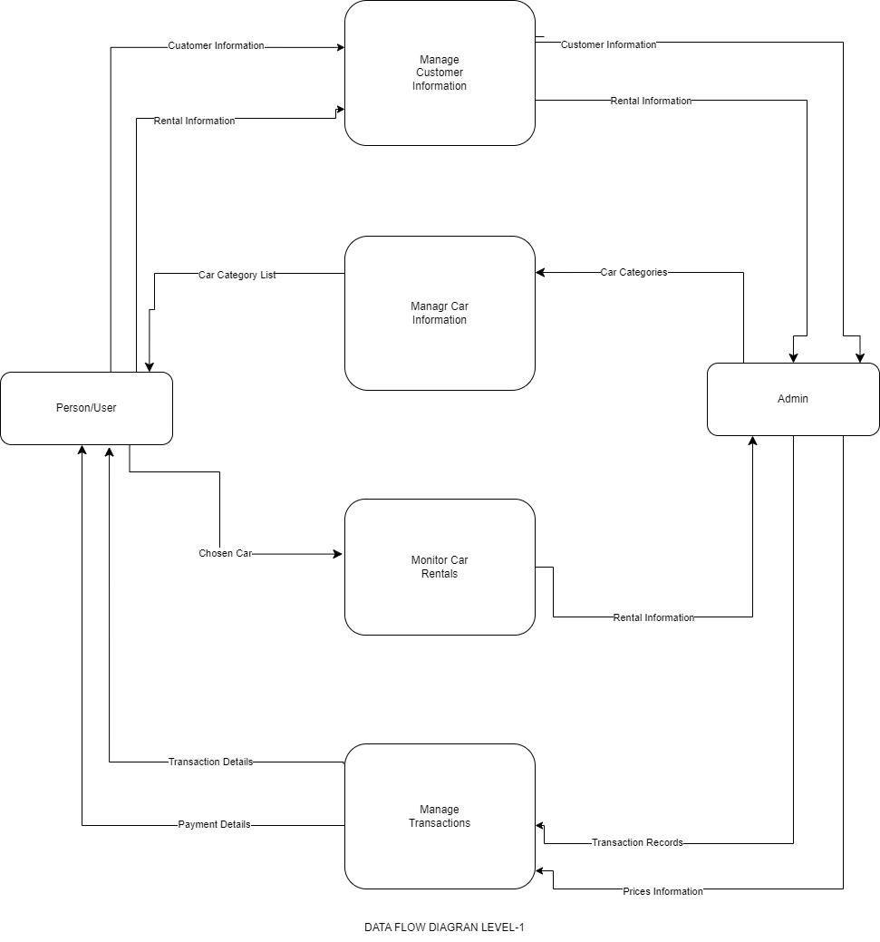
DFD 1:

Slide 13
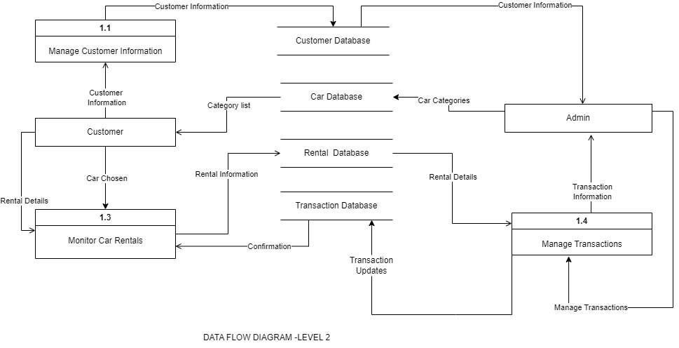
DFD 2:

Slide 14
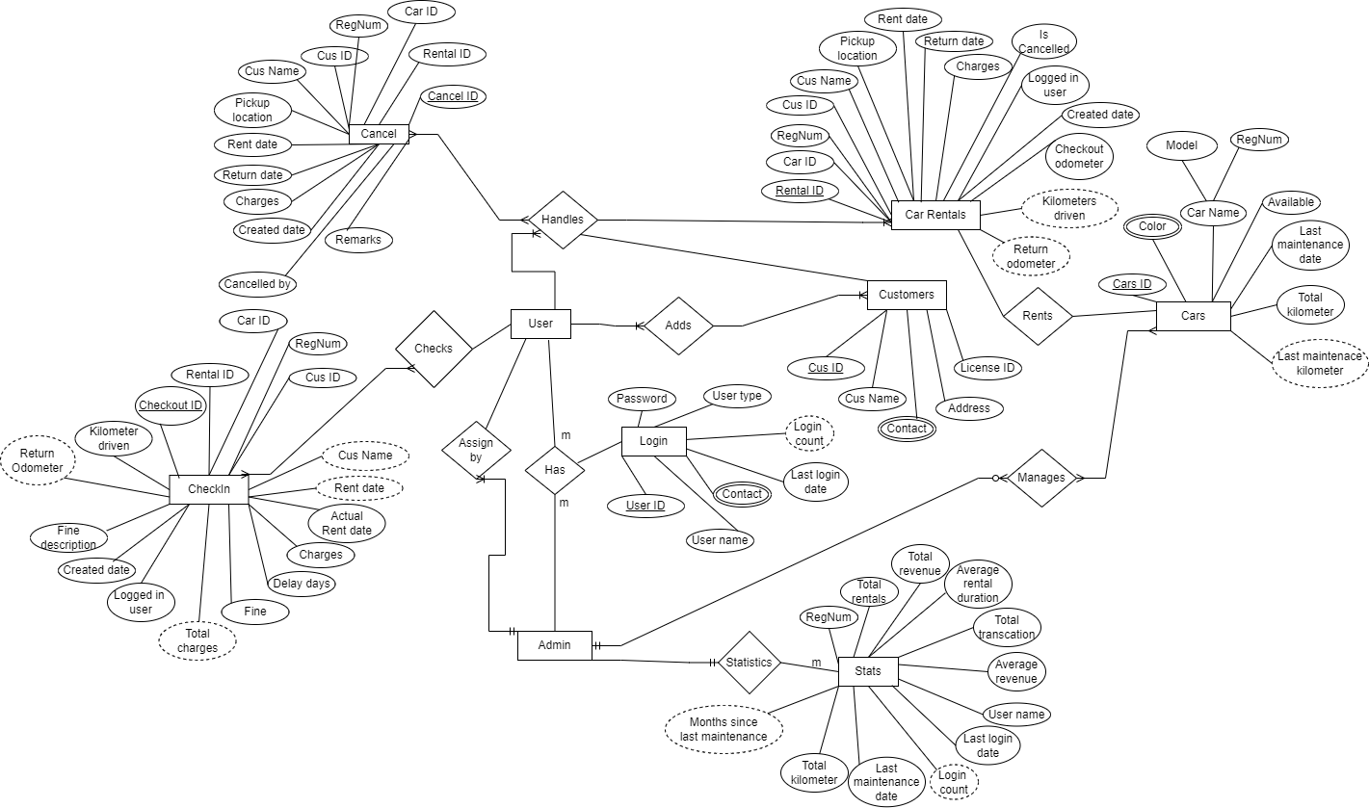
Er- Diagram:

Slide 15
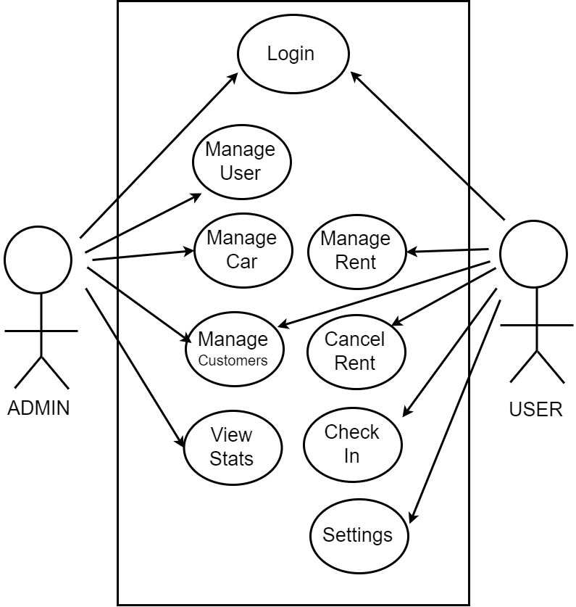
Use Case Diagram:

Slide 16
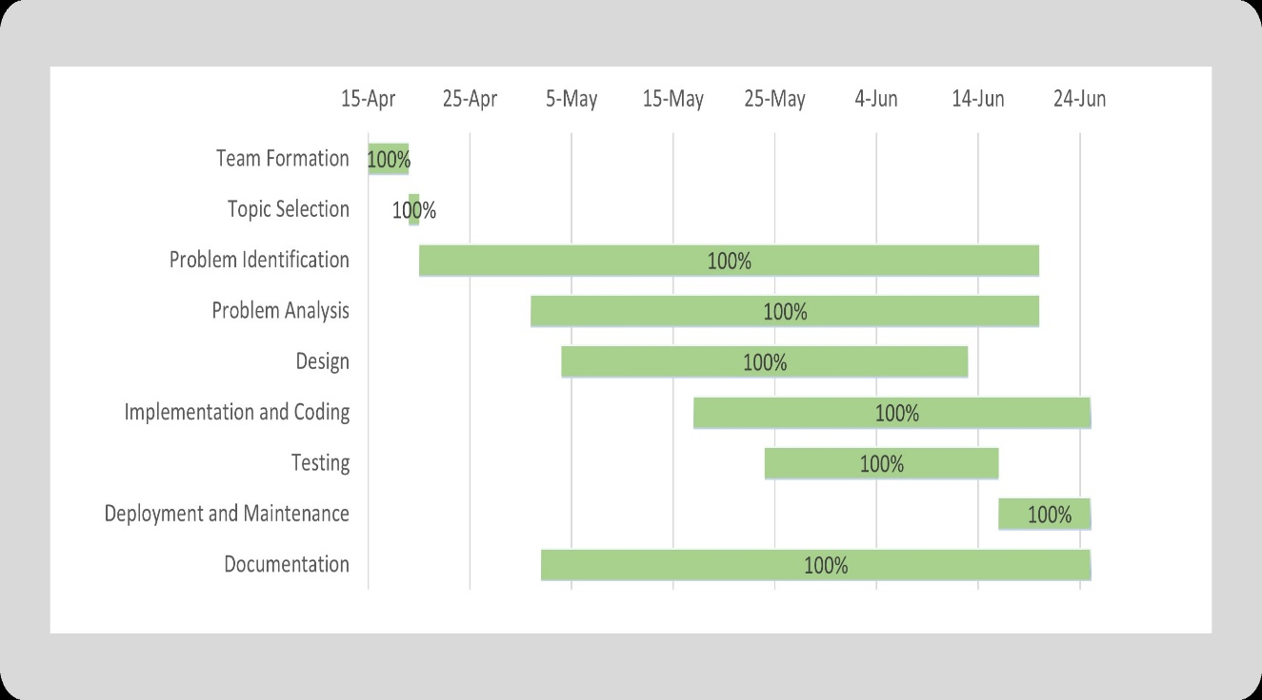
GANTT CHART:

Slide 17
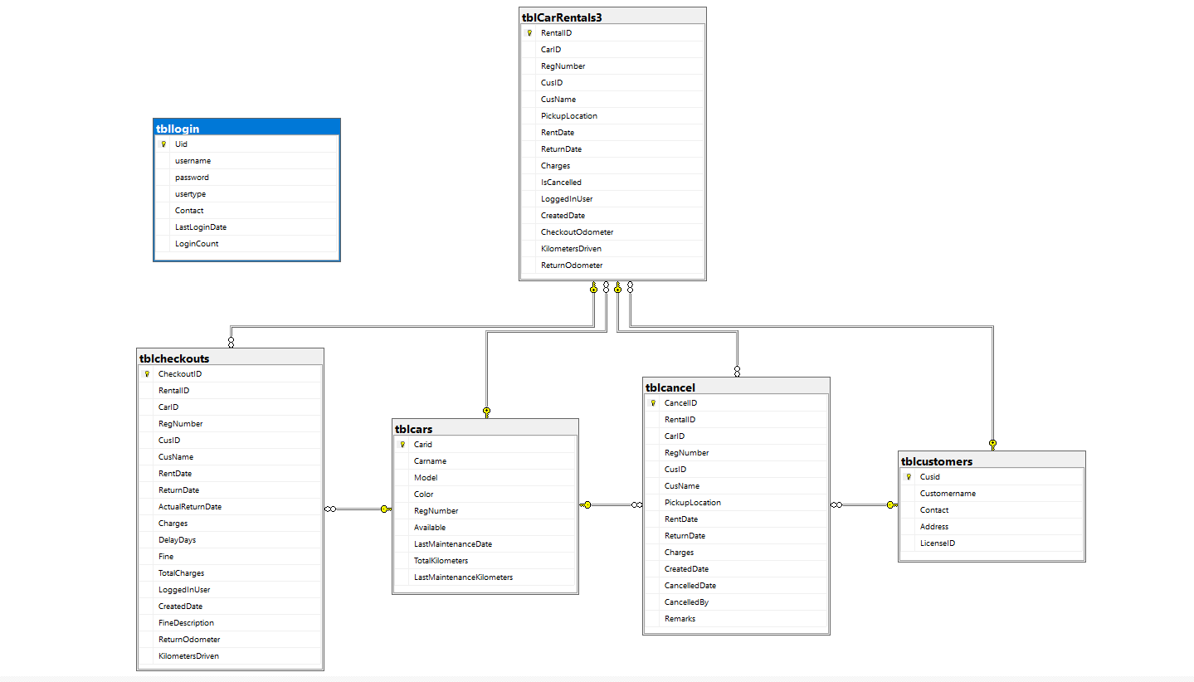
Database Schema:

Slide 18
Work Division Chart:
S.N | Name of the member | Work assigned | Remark
1. | Namrata Bastola | Documentation UI design Functionality testing | Managed documentation, contributed to UI design, and tested application functionalities.
2. | R.A Mohan Tiwari | Coding Database Management Problem identification Requirement document | Led the project, handled all coding, database management, and problem-solving.
3. | Rikita Gharti | Documentation UI design Functionality testing | Led documentation efforts, contributed to UI design, and conducted functional testing.
4. | Subash Gurung | System design Documentation UI design Full functionality testing | Designed system architecture, created a significant portion of the UI, and performed comprehensive functionality testing.

Slide 19
DEMO

Slide 20
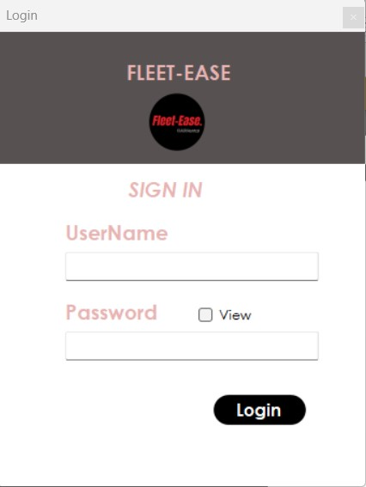
Login Page:

Slide 21
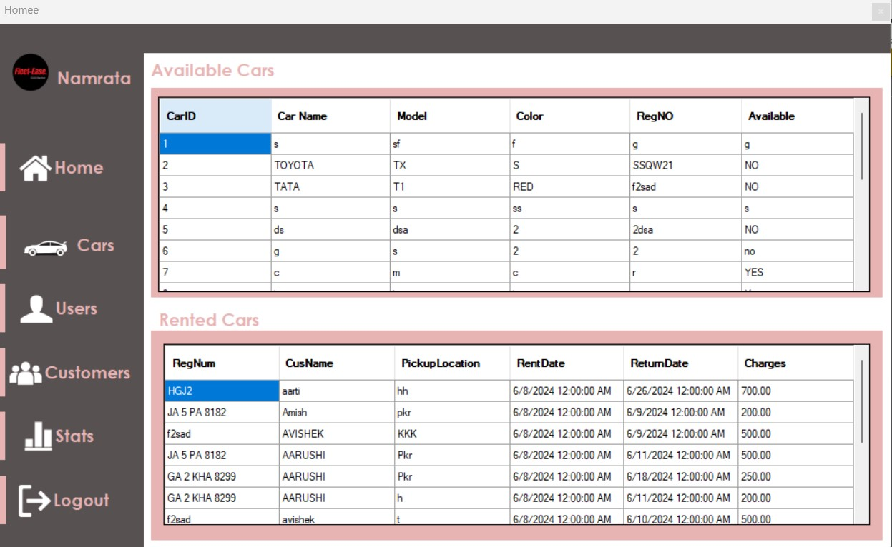
Home Page:

Slide 22
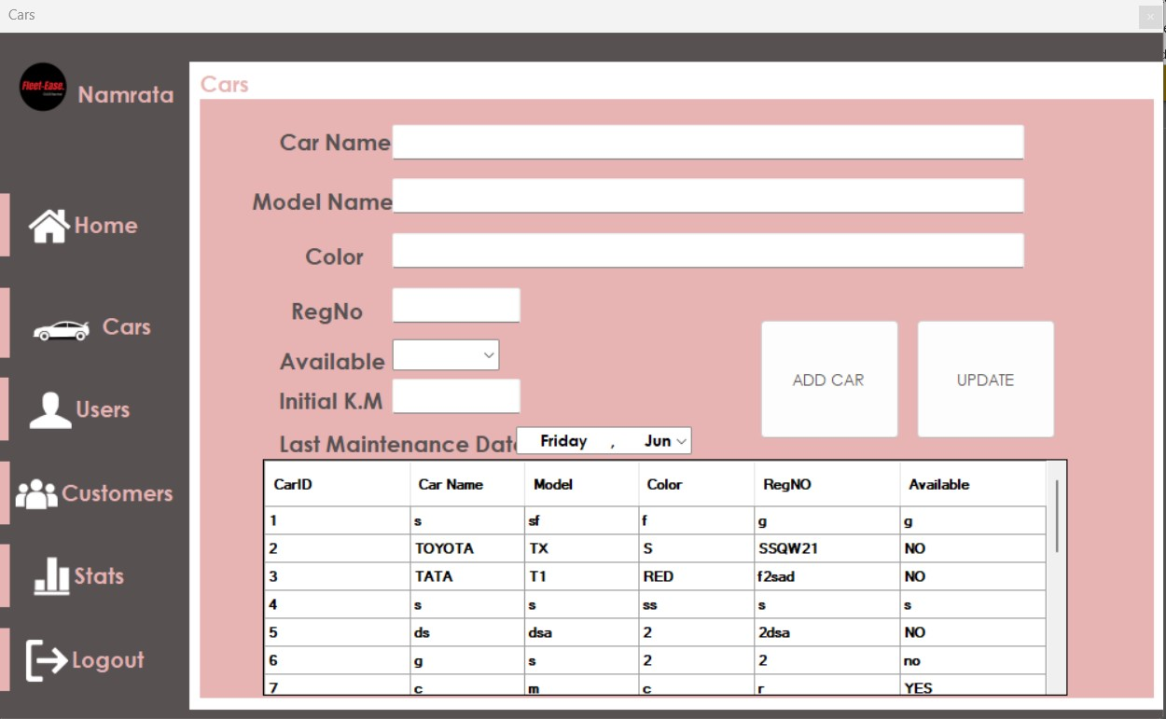
Add Cars:

Slide 23
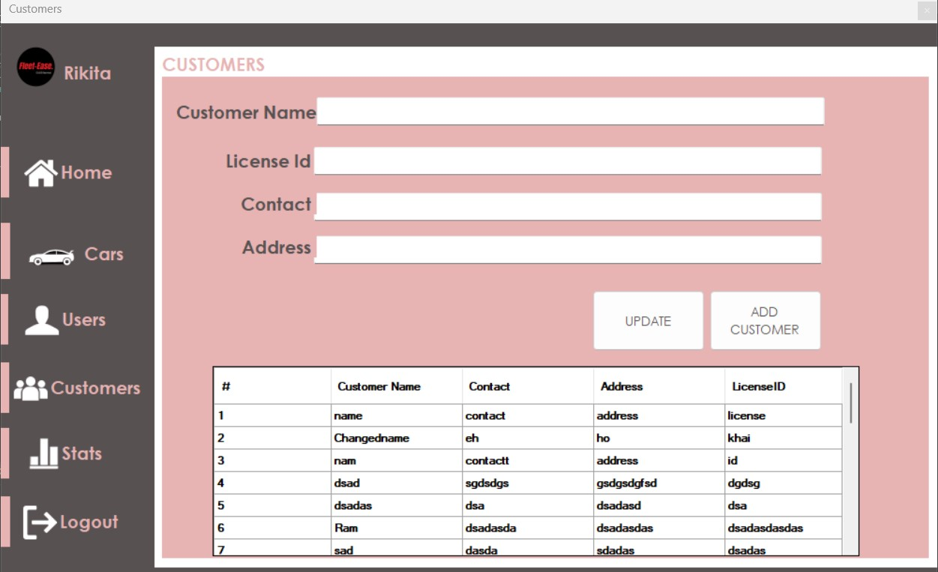
Add Customers:

Slide 24
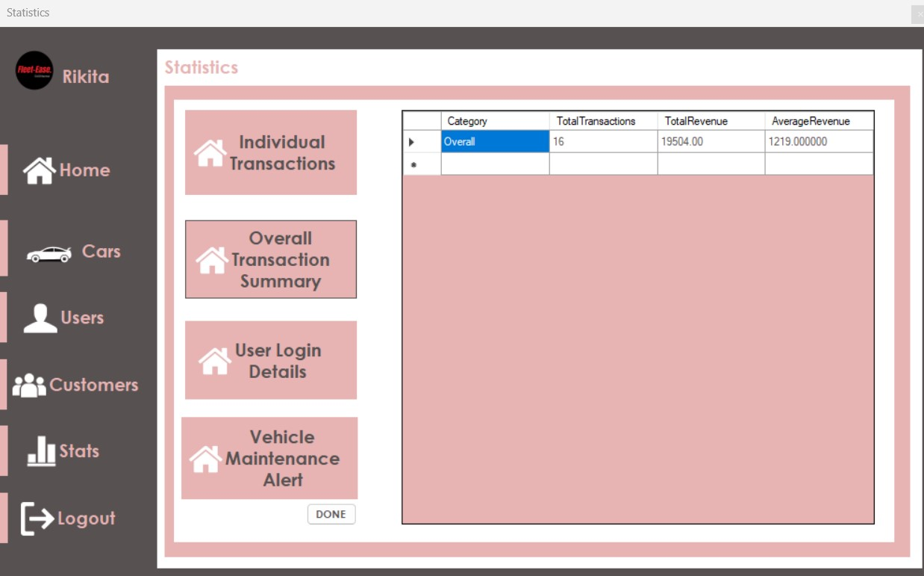
Statistics:

Slide 25
PROJECT’S RESULTS​
What are the functions achieved by our project?
What Problems have been solved by our project?
What requirements have been met?
What makes our Project different from others?

Slide 26
FUTURE ENHANCEMENTS
Enhanced UI/UX
Data Backup and Security
Driver Verification and License Management
Advanced Car management features

Slide 27
THANKYOU
WE’RE OPEN FOR Q&A

